Slide 1






SoCFlow: Efficient and Scalable DNN Training on SoC-Clustered Edge Servers
Daliang Xu*, Mengwei Xu*, Chiheng Lou, Li Zhang, Gang Huang, Xin Jin, Xuanzhe Liu
^{(*co-primary)}
Notes:
Hello, everyone. I am Daliang from peking university. I’m glad to share our work: SoCFlow: Efficient and Scalable DNN Training on SoC-Clustered Edge Servers

Slide 2
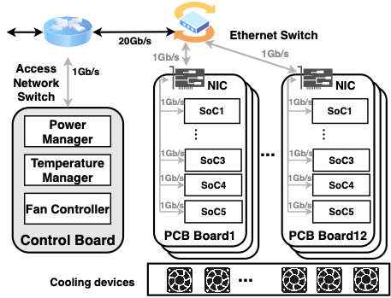
SoC-Cluster
1Gbps
60 Mobile SoCs
12 PCB Boards
Notes:
SoC-Cluster is an emerging form of server, including massive mobile system-on-chips (SoCs).
Specifically，we use a commercialized SoC-Cluster we have deployed as an example.
It contains 60 Qualcomm Snapdragon 865 chips and a control board.
These chips are mounted on 12 printed circuit boards (PCBs), with five on each, and have 1 Gb/s bandwidth between PCBs.

Slide 3

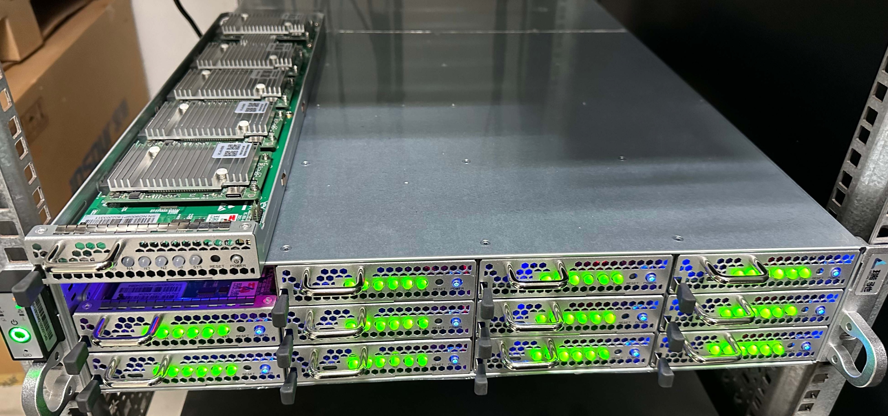
SoC-Cluster
CPU | 1 x 2.84 GHz Kryo 585 + 3 x 2.42 GHz Kryo 585 + 4 x 1.8 GHz Kryo 585
GPU | Qualcomm Adreno 650
NPU | Hexagon 698 DSP
Memory | 12GB LPDDR5
Disk | UFS 3.1 256GB
OS | Android 10 (Kernel 4.19.81)
Network Interface | 1 x 1GE RJ45 Port (1Gbps) + 2 x 10GE SPF+ Port (2 x 10Gbps)
Physical Interface | 2 Rack Unit
60 Mobile SoCs
12 PCBs
Notes:
Its physical structure is shown in this picture.
It can deliver dense computing capacity，such as 60x Snapdragon 865, thus 480x physical cores in a 2U rack.
(click1)
Each chip in the cluster has an octa-core Kryo 585 CPU, an Adreno 650 GPU, a Hexagon 698 digital signal processor (DSP) that can function as a type of NPU, and 12GB LPDDR5 memory

Slide 4





SoC-Cluster
live streaming
Deploy
cloud gaming
Notes:
Since each SoC is same as a smartphone chip which has the same ability to run native mobile applications without any modification,
millions of them have been deployed in edge clouds or base stations to serve mobile applications, such as cloud gaming and live streaming.

Slide 5

SoC-Cluster is under-utilized
The average CPU usage of more than 95% of SoCs is under 20%
Distributed deep learning training?
Harvest
Notes:
However, from the real-world deployment traces, we find that such soc-clusters are severely under-utilized,
click1
e.g., the average CPU usage of more than 95% SoCs is under 20% from 3 am to 8 am.
(click2)
To harvest such free cycles, can we perform deep learning (DL) training tasks on idle SoCs since Training workloads are predictable and delay-tolerable?

Slide 6
Challenges
2.3-9.8x latency
Scarce network bandwidth.
< 1Gbps
5.9-8.2% accuracy loss
Heterogeneous processors with mixed data formats.
INT8 for NPU
FP32 for CPU
Notes:
we find two distinct challenges when doing that.
(click1)
The first one is Scarce network bandwidth, that is less than 1Gbps. Such network bandwidth is enough for cloud gaming but too weak for distributed training.
(click2)
Our evaluation on 32 SoCs finds that 32-SoC inter-PCB board gradient communication delay is 2.3–9.8× more than that of 4 SoCs.
(click2)
The second one is Heterogeneous processors with mixed data formats. Mobile SoCs typically contains CPU for FP32 computation and NPU for INT8 computation.
(click3)
Such heterogeneity leads to more than 5% accuracy loss for VGG-11 and ResNet18 models.

Slide 7
SoCFlow workflow
Input the training datasets and the DNN to be trained
3⃣️
Dispatch the training data and model to each SoC
1⃣️
Determines how SoCs will be orchestrated, such as SoC grouping
Perform FP32-based training on CPU, Int8-based training on mobile NPU
2⃣️
4⃣️
Notes:
To solve this problem, we propose SoCFlow.
The first framework that can efficiently train DNN models on SoC-Cluster servers.
（click1 2）
SoCFlow takes the training datasets and the DNN to be trained as input.
（click3 4）
Ahead of the training, it determines how SoCs will be orchestrated, such as SoC grouping, gradients synchronizing frequency, and aggregation methodology.
(click 5 6)
Then, it dispatches the training data and model to each SoC.
(click 7 8)
It supports FP32-based training on CPU, Int8-based training on mobile NPU, or mixed-precision training with both.

Slide 8
SoCFlow
#1: Group-wise parallelism with delayed aggregation.
#2: Data-parallel Mixed-precision Training.
Notes:
It includes two novel techniques.
（click1）
First, We propose the Group-wise parallelism with delayed aggregation to mitigate the network bottleneck problem.
（click2）
For the second challenge, we propose a new Data-parallel Mixed-precision Training algorithm to improve convergence accuracy.

Slide 9
SoCFlow
#1: Group-wise parallelism with delayed aggregation.
#2: Data-parallel Mixed-precision Training.
Notes:
For the first technique,

Slide 10

Group-wise parallelism with delayed aggregation
Key idea: The network capacity of the SoC-Cluster lies somewhere between the high-speed data center and the wireless network
Epoch-grain: Inter-group weights aggregation
Batch-grain: Intra-group gradients aggregation
Notes:
Our key idea is that The network capacity of the SoC-Cluster lies somewhere between the high-speed data center and the wireless network.
(click0)
To that end, we propose a hierarchical topology that enables group-wise parallelism across SoCs.We divide SoCs into different groups.
（click1）
Within a logical group, the SoCs form a Ring-AllReduce topology and exchange their model updates frequently, i.e., per batch.
（click2）
Across logical groups, the weights are aggregated in a delayed manner and infrequently, i.e., per epoch.

Slide 11
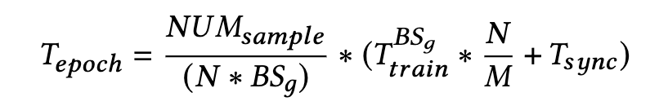
Determine group size (N)
Per-epoch training time is negatively correlated to group number (N).
Convergence accuracy exhibits a negative correlation with group number (N).
(N)
(N)
Larger N => A higher convergence accuracy
Smaller N => A lower training time
Notes:
To achieve this, socflow should first determine the group size.
(click1)
Typically, Per-epoch training time is negatively correlated to group number N.
(click2)
However, higher convergence accuracy requires a small group number (N).
(click3)
How to determine the group size to trade-off convergence accuracy and training time is an important problem.

Slide 12
Determine group size
Observation: The training accuracy observed during the initial epoch closely mirrors the behavior of convergence accuracy.
logical group size
Notes:
Luckily, our observation finds that the training accuracy observed during the initial epoch closely mirrors the behavior of convergence accuracy.
To that end, during the warm-up stage, socflow profiles the training accuracy from a smaller group size to a larger one.
It halts at the first group size where accuracy falls significantly, typically to around 15%,

Slide 13
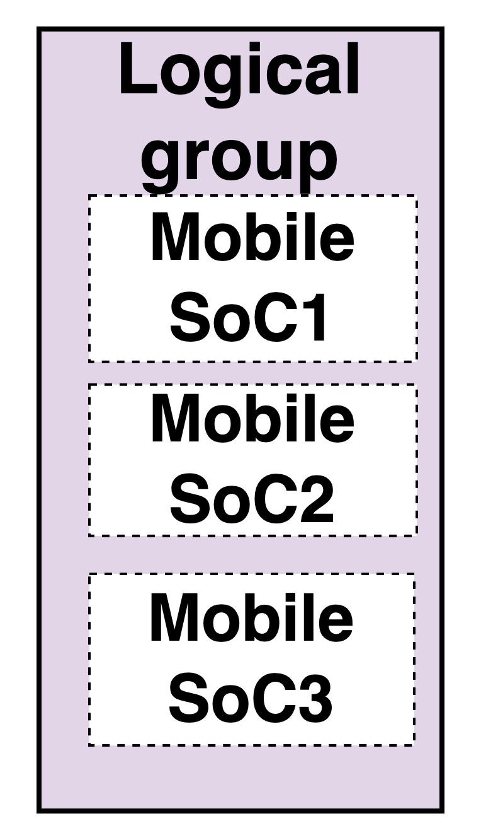
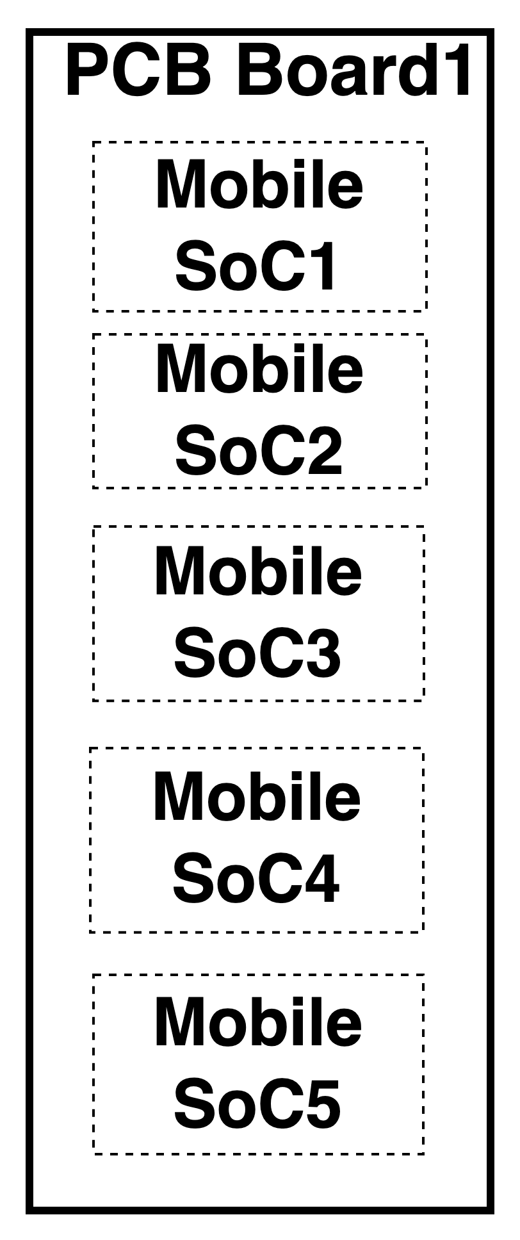
Map logical to physical topologies
Group size != physical PCB SoC size
Logical group size = 3
Physical PCB size = 5
Inter-PCB communication
contention
problem
Accuracy-speed trade-off
Hardware design
Notes:
In general, the logical group size cannot always be equal to the physical PCB SOC size.
The situation arises because the logical group size is determined by trading off convergence accuracy and training speed, while the physical PCB soc size is determined by the hardware design.
(click1)
In this situation, different SoC groups will contend for the scarce inter-PCB communication bandwidth, as each group has to perform per-batch gradients synchronization simultaneously.

Slide 14
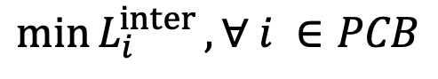
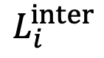
Map logical to physical topologies
Group size != physical PCB SoC size
The number of logical groups contending for inter-PCB communication.
Inter-PCB communication
contention
$$L_{i}^{inter}$$
depict
Mapping goal: find the minimum contention.
${\min{L}}_{i}^{inter},∀ i ∈PCB$
Notes:
To solve this problem, we first use L i hat inter, the the number of logical groups contending for inter-PCB communication to depict contention level.
The larger L i inter represents more contention.
A larger Li inter means more contention.
(click2)
Then, we formulate a mapping problem to minimize the overall contention across PCBs.

Slide 15
Integrity-greedy mapping
Key idea: All SoCs of a logical group mapped to a single PCB board will not contend for inter-PCB network communication.
Step 1: map as many logical groups as possible to physical groups without splitting.
Step 2: the rest of the logical nodes are mapped in sequence.
Theorem 1: Integrity-greedy mapping minimizes C.
Theorem 2: Integrity-greedy mapping guarantees that each logical group contends with up to two other logical groups for NIC.
Notes:
To solve this problem, we propose Integrity-greedy mapping algorithm.
Our key idea is that all SoCs of a logical group mapped to a single PCB board will not contend for inter-PCB network communication, like logical group 1.
（click1）
Thus, SoCFlow first maps as many logical groups as possible to physical groups without splitting, as shown in logical group 123.
(click2)
Second, the rest of the logical socs are mapped in sequence.
(clicke3)
We have proved that such mapping method can minimize the inter-PCB communication contention, and the largest contention number is 2.

Slide 16
Group-wise communication planning
The maximum value of inter-PCB communication contention is two
Inter-PCB communication
contention
Notes:
nevertheless, in many cases, there are still two logical groups contending for inter-PCB contention after mapping topology, shown in theorem 2.

Slide 17
Group-wise communication planning
Key idea: We can divide groups with contention into different communication groups (CGs) to communicate separately in sequence to avoid network contention.
Theorem 2 guarantees 2 communication groups at most.
Notes:
To further avoid contention, our key idea is that We can divide groups with contention into different communication groups (CGs) to communicate separately in sequence to avoid network contention.
(click1)
Theorem 2 guarantees in our situation there are 2 communication groups at most.
To that end, socflow uses a pipeline of two CGs to hide the intra-group communication time.

Slide 18
SoCFlow
#1: Group-wise parallelism with delayed aggregation.
#2: Data-parallel Mixed-precision Training.
Notes:
For the second technique,

Slide 19
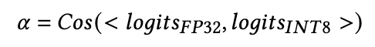
Data-parallel Mixed-precision Training
Key idea: Compensate the precision loss of INT8-based training by offloading part of the training to the CPU with FP32 format
Two metrics
𝛼 – confidence that indicates the error gap between the INT8 model and the FP32 model.
𝛼-> 1 => The INT8 Model is more accurate.
𝛼-> 1 => More training data should be fed into the INT8 model.
Notes:
Our key idea is that we can compensate the precision loss of INT8-based training by offloading part of the training to the CPU with FP32 format.
To control how much data should be input to the INT8 models, we propose two metrics.
（click1）
Alpha is confidence metric that indicates the error gap between the INT8 model and the FP32 model. When alpha approaches to one, The INT8 Model is more accurate and more data should be fed into INT8 model.

Slide 20
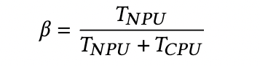
Data-parallel Mixed-precision Training
Key idea: Compensate the precision loss of INT8-based training by offloading part of the training to the CPU with FP32 format
Two metrics
𝛽 – compute power ratio that represents the ratio of compute power for heterogeneous processors
𝛽-> 1 => NPU is more powerful.
𝛽-> 1 => More training data should be fed into the INT8 model.
Notes:
Beta is compute power ratio that represents the ratio of compute power for heterogeneous processors. When beta approaches to one, it means NPU is more powerful to process more training data, so more data should be fed into INT8 model.

Slide 21


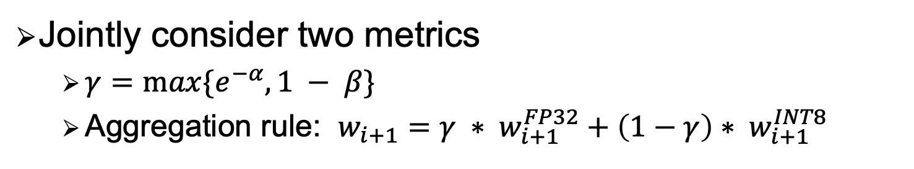
Data-parallel Mixed-precision Training
Key idea: Compensate the precision loss of INT8-based training by offloading part of the training to the CPU with FP32 format
Jointly consider two metrics
$γ=\max{\{e^{−α}, 1 − β\}}$
Aggregation rule: $w_{i+1}=$ $γ ∗ w_{i+1}^{FP32}+\left(1−γ\right)∗ w_{i+1}^{INT8}$
Training data
FP32: $γ$
INT8: 1-$γ$
Training model
FP32 Model
INT8 Model
Aggregation
Notes:
When jointly considering accuracy requirements and performance issues, we propose $γ$, the max value of $e^{−α}, (\text{e} \text{to} \text{the} \text{power} \text{of} \text{n}) 1 −β.$ when 𝑒 −𝛼 is smaller than 1-𝛽, NPU processing capacity is not enough and the CPU is idle, so feeding more data into NPU cannot gain any benefit.
The final weights are aggregated from the FP32 weights and INT8 weights.

Slide 22
Evaluation: settings
Models and datasets
SoC-Cluster
SnapDragon 865 SoC x 60
Model | Dataset | Learning methods
LeNet | FMNIST and Fashion-MNIST | From scratch
VGG-11 | CIFAR-10 and CelebA | 1.35G
ResNet-18 | CIFAR-10 and CelebA | 7.26G
MobileNet-V1 | CIFAR-10 | 2.43G
ResNet-50 | CINIC-10 | Transfer learning
Baselines
4 Distributed machine learning baselines
2 industry baselines : Parameter server and Ring-AllReduce
2 SOTA research baselines: HiPress [SOSP 21] and 2D parallelism [ASPLOS 23]
2 Federated learning baselines: FedAvg and Tree FedAvg
Notes:
We implement an end-to-end prototype of socflow on the Android OS.
Our evaluation contains 5 DNN models with 2 learning methods.
We evaluate 6 baselines on 60 SoCs, including two industry Distributed machine learning baselines Parameter Server and ring-all reduce, two SOTA research baselines HiPress published in sosp 21 and 2D parallelism published in asplos 23, and 2 federated learning baselines FedAvg and Tree FedAvg.

Slide 23
Evaluation: End-to-end Performance
Only SoCFlow can guarantee that all training tasks finish within two hours smaller than the SoC-Cluster idle time.
47.9–730×
3.7–58.5×
3.14×
7.1–61.6×
2.42×
6–120.3×
Latency (hours)
Latency (hours)
Notes:
Our evaluation show that Only SoCFlow can guarantee that all training tasks finish within two hours, which is smaller than the SoC-Cluster idle time, so that the model can be updated every day.
It can achieve a up to 294 times training speedup.
That is because our techniques can mitigate the network contention and fully unleash the NPU’s computing power in the data-parallel training.

Slide 24
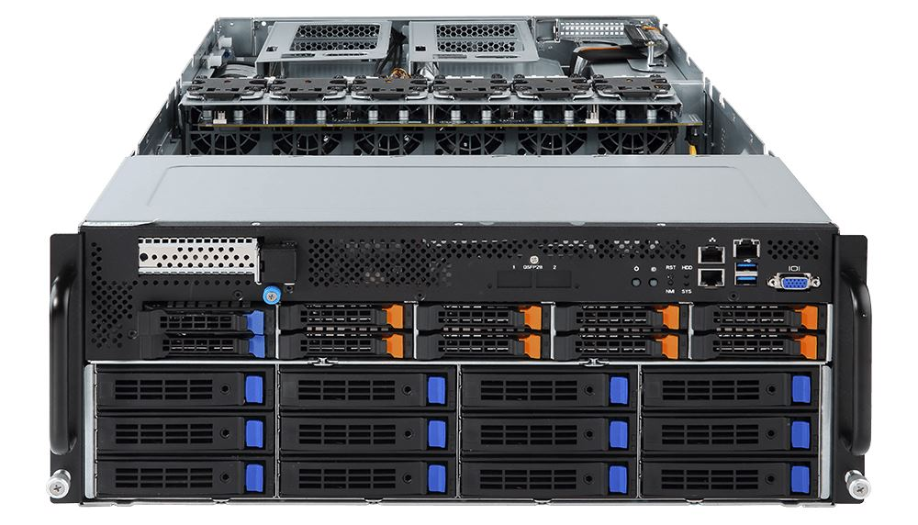

Evaluation: Comparison with Cloud GPUs
SoCFlow are more suitable for training small-to-medium size models (MobileNet) than Cloud GPUs.
Training
workloads
Training
workloads
Training
workloads
Training
workloads
Training
workloads
Training
workloads
Training
workloads
Training
workloads
Training
workloads
Training
workloads
Training
workloads
Training
workloads
Reduce 10.2×
Energy consumption
V100 GPU
Simpler cooling system
Mobile SoC
1/2 volume
SoC-Cluster
V100 Server
Notes:
When compared with cloud GPUs, SoCFlow are more suitable for training small-to-medium size models (MobileNet).
It can reduce 10.2 times energy consumption and save half room.
The situation arises because mobile socs are designed for small-to-medium size edge DNN models.

Slide 25

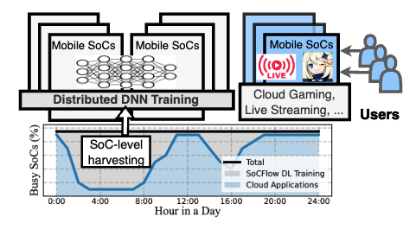



Take-away
Propose first efficient DNN training engine for SoC-Clusters
Incorporate group-wise parallelism and data-parallel mixed-precision training
SoCFlow
Build prototype and achieve superior performance over existing methods
xudaliang@pku.edu.cn
https://daliangxu.github.io/
More about our affordable AI systems: http://www.liuxuanzhe.com
Notes:
In conclusion,
We have proposed The first efficient DNN training engine for SoC-Clusters.
It exploits group-wise parallelism and data-parallel mixed-precision training to achieve both high training speed and negligible accuracy loss.
Thanks for your listening.
If you have any questions about SoCFlow, please ask Daliang Xu via this e-mail address.
If you are interested in our affordable AI systems, please refer to this web site for more details.

